Slide 1
Automating Customer Experience Audit using Per-trained Generalized Models
REVA Academy for Corporate Excellence (RACE)
06-Mar-21
Saumyadip Sarkar
Deputy Manager, BI & Analytics, Oracle
www.reva.edu.in

Slide 2
Agenda
01
06
Introduction
Data Preparation
02
08
Problem Statement
Modeling
03
09
Methodology
Evaluation
04
10
Objective
Result
05
11
Business Understanding
Conclusion
06
12
Data Understanding
Q/A

Slide 3


Introduction
But how do we ensure this ?
Product Centric
Customer Centric

Slide 4

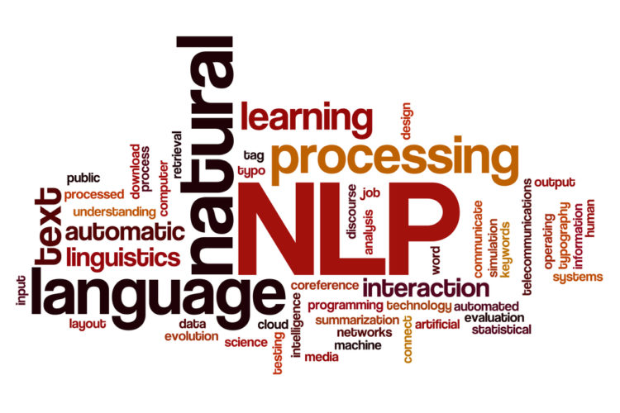
Problem Statement
Identify Sample
Manual Audit
Calibrations
Manual Errors
Time Consuming
Ambiguity during calibration

Slide 5
Objective
Identify
Audit Parameters
Explore
Pre-trained NLP models
Reduce
Manual Effort & Time

Slide 6
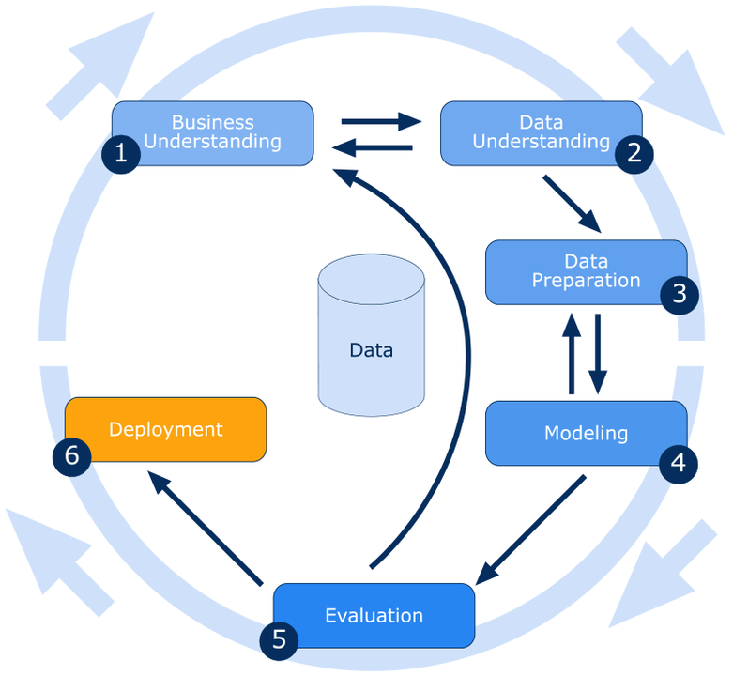
Project Methodology
Audit team responsible for identifying the quality of responses
Text Data from email communication
Identify customer queries and corresponding responses
Pre-trained Transformer models (Q/A & Sentiment Pipe-line)
Validate the accuracy of the model against original findings
Handover the model to auditors
CRISP-DM

Slide 7
Business Understanding
How is our response?
Finance Department responsible for resolving Invoice related issues
Customer query
Response by analyst
Resolved / Escalated
Audit Samples are identified using stratified random sampling
Samples are evaluated based on defined Audit Parameters
Final Score is published based on audit findings
Calibration happens between auditor and master auditor (Usually a SME)
Parameter | Detailed Questions
Issue Identification | Did the employee understand customer requirements?
Courtesy/Empathy | Did the employee display courteousness/empathy?

Slide 8
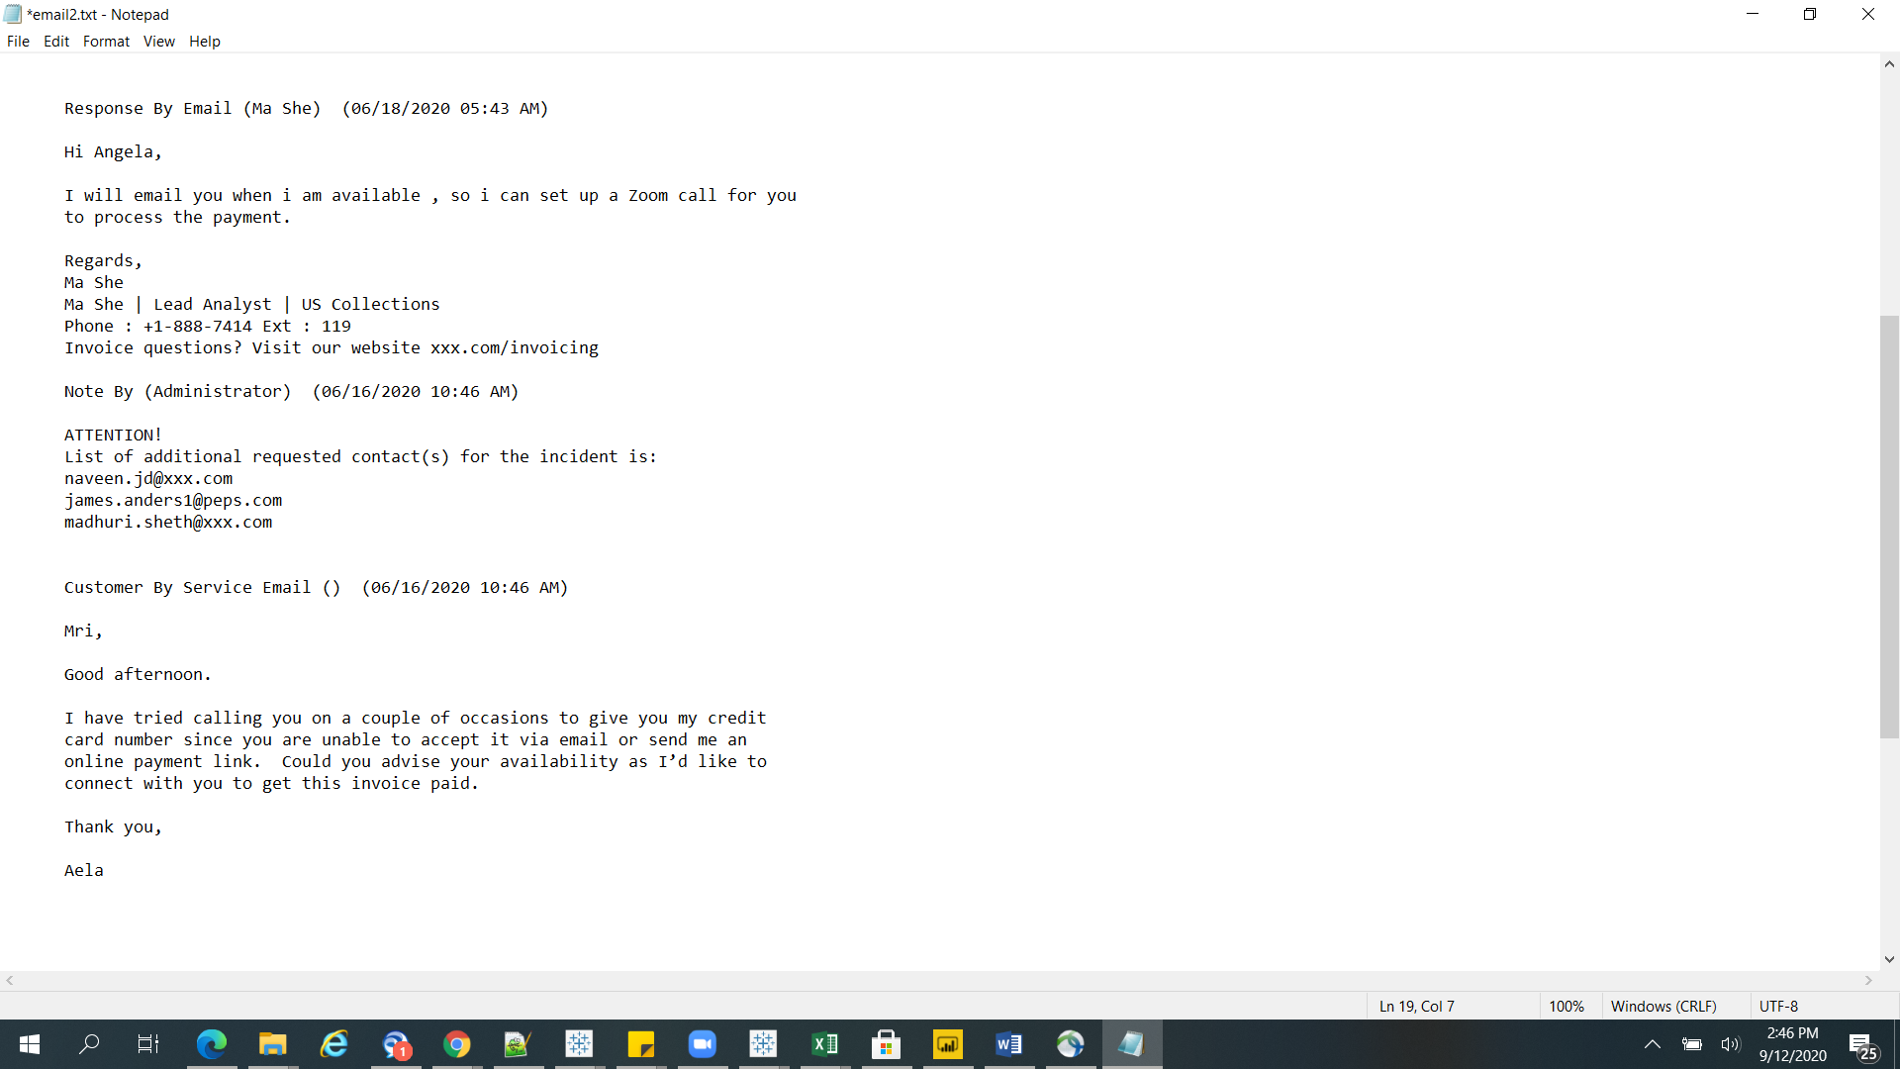
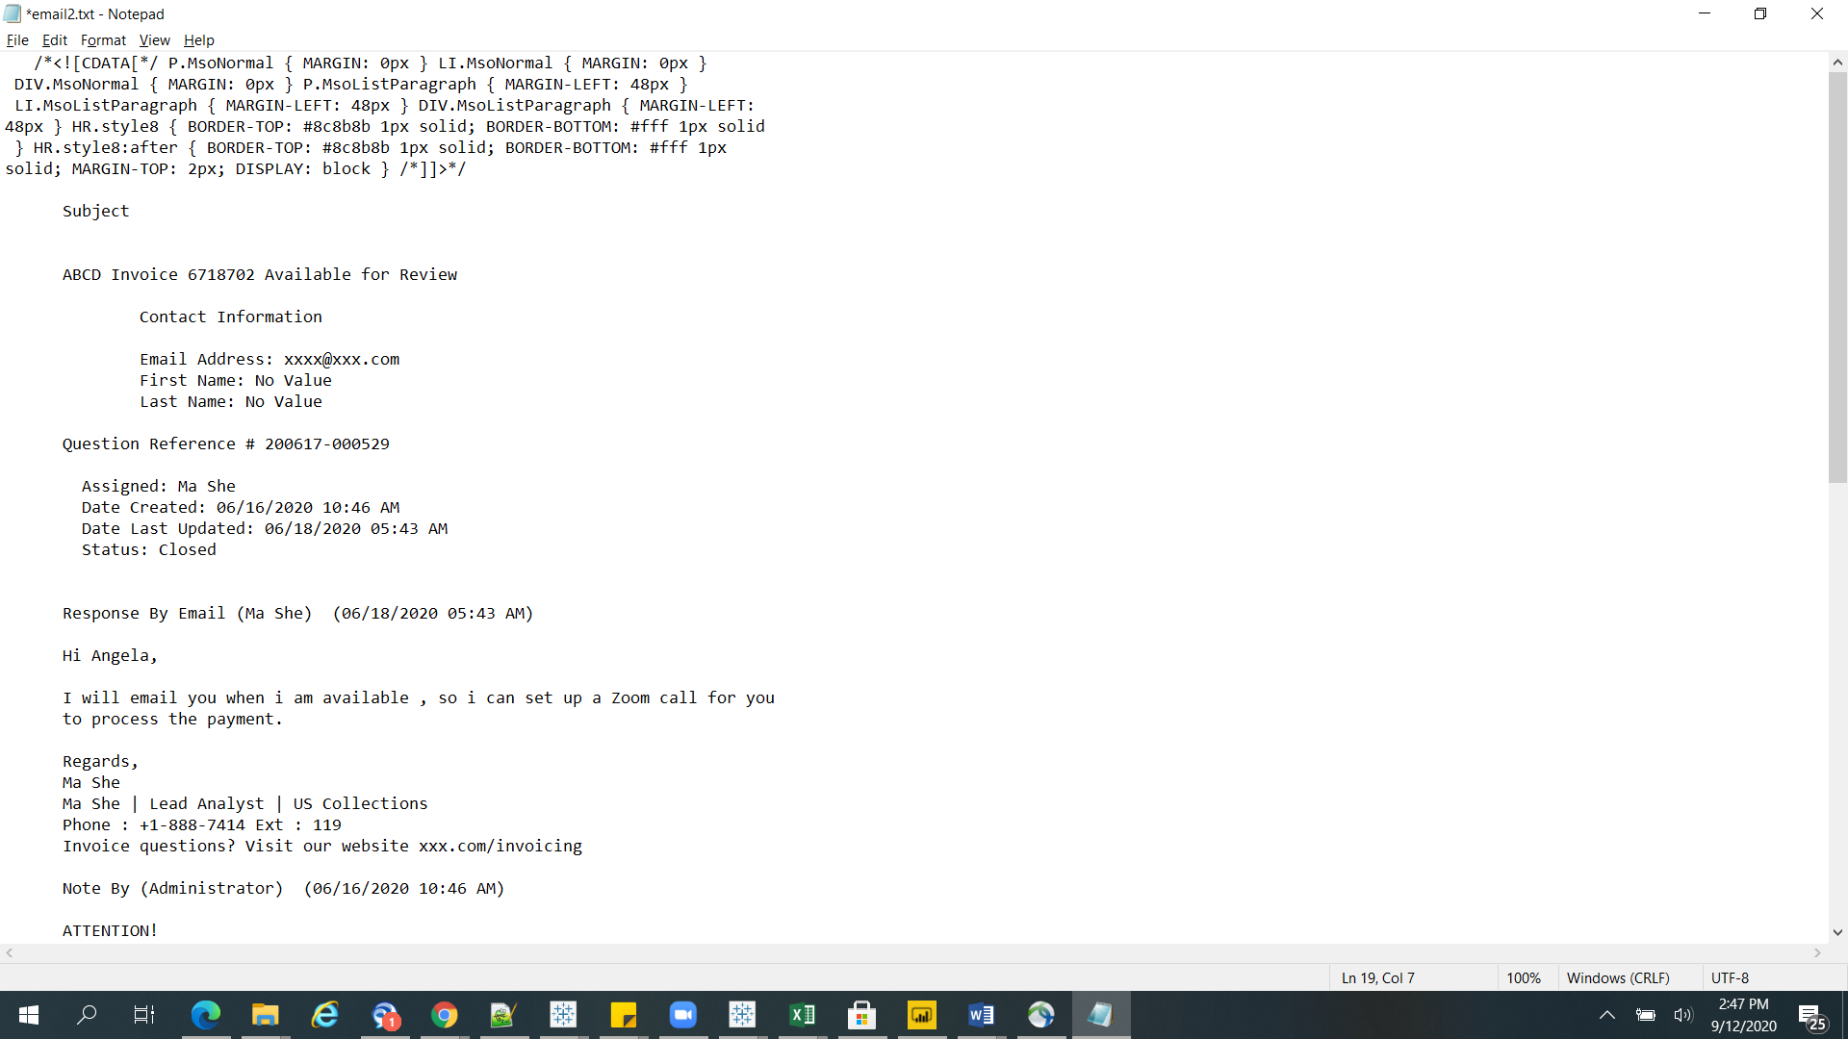
Data Understanding
Question Reference
Generated when an email is sent by customer.
It is also called Incident Numbers
Subject
As specified by customer
Mail from Customer
Query from Customer
Appears under Customer By Service Email
Response by Analyst
Appears under Response By Email
Response by Analyst

Slide 9
Data Preparation
Scope – Queries resolved in one response (60% of samples)
Data is downloaded manually for each sampled incident
Customer queries and corresponding responses are extracted as is
Extracted queries and responses are then fed into model

Slide 10
Modeling
Hugginface Transformer architecture
DistilBertForQuestionAnswering
bert-large-uncased-whole-word-masking-finetuned-squad
distilbert-base-uncased-finetuned-sst-2-english
Context based response
Sentiment Analysis

Slide 11
Modeling
Data Pipeline for ‘question-answer’
Customer query and corresponding response is extracted
Customery query is then fed as Question is Q/A pipeline
Response is fed as Context in Q/A pipeline
Probability Score & Answers or Key error is the outcome
Data Pipeline for ‘sentiment analysis’
Customer query and corresponding response is extracted
Response is fed as statement to be predicted for sentiment
Probability Score and Sentiment (Positive / Negative / Neutral) are the outcomes

Slide 12
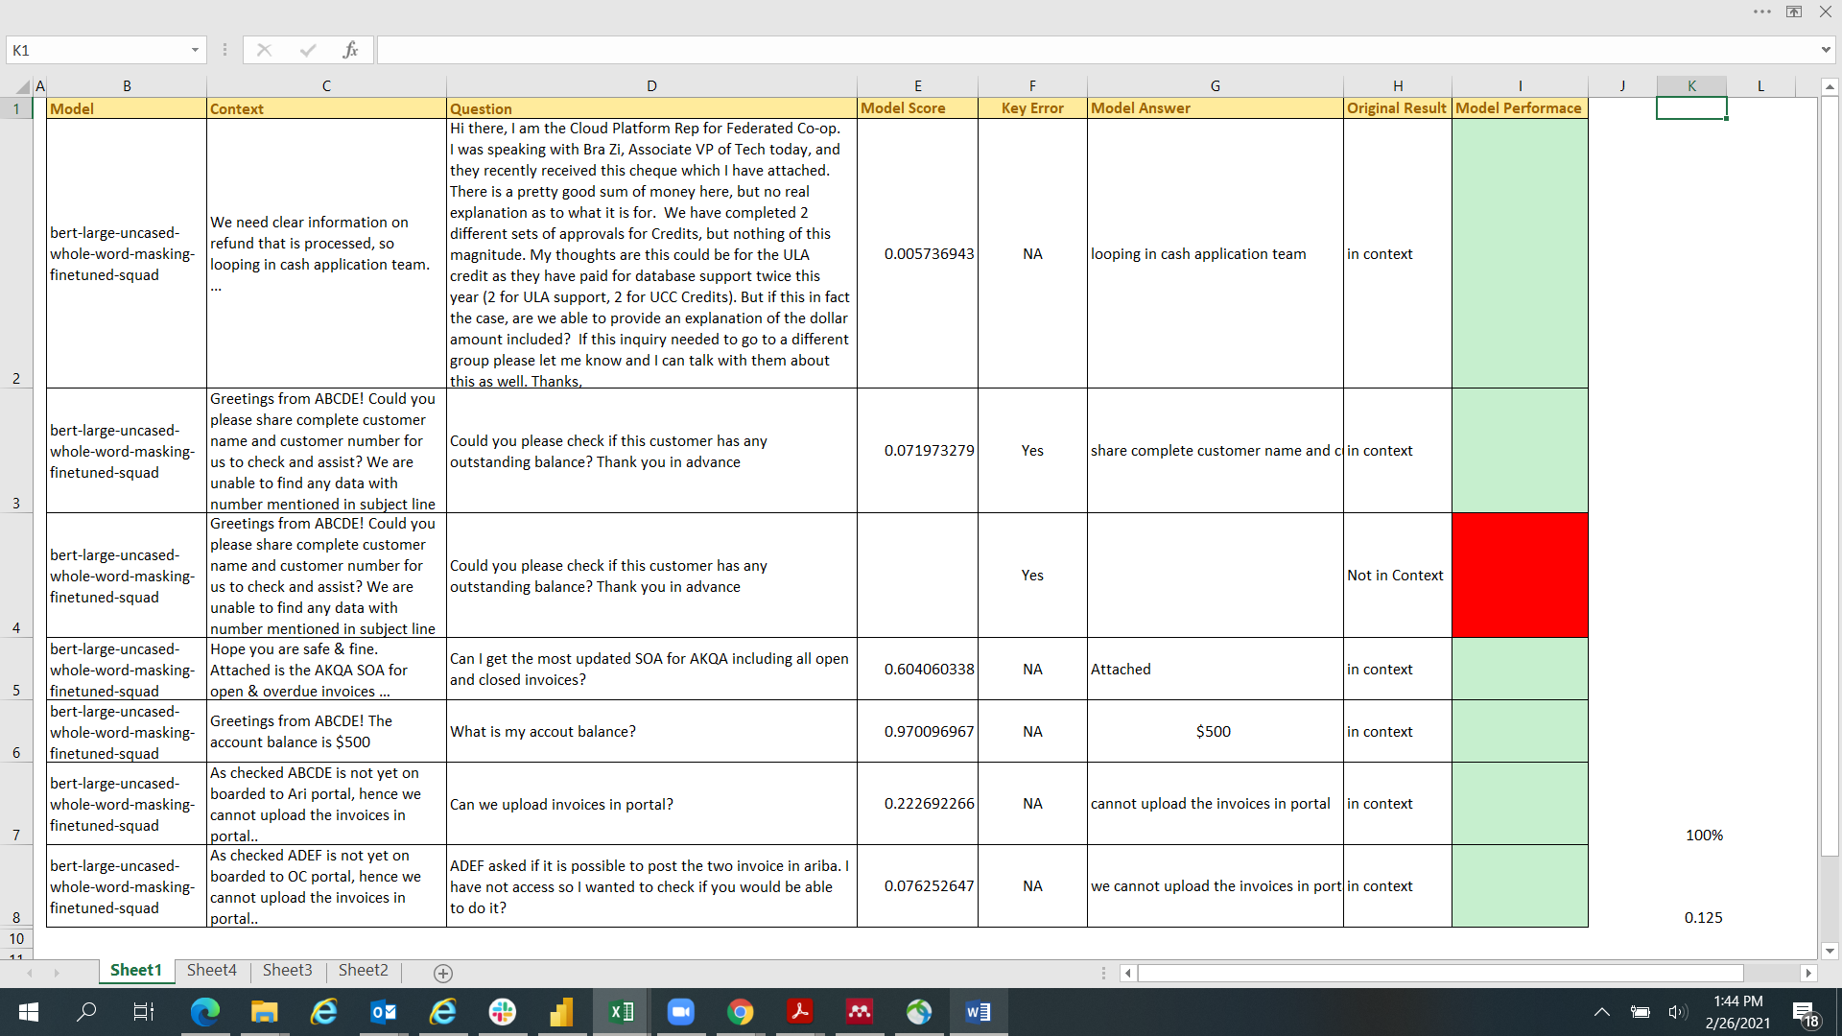
Data Evaluation
Context based response
Since these are pre-trained model, no training data was required. It’s applied on actual data.
The outcomes are “Probability Score” and “Model answer”
If the model is not able to understand the context, it throws a Key Error

Slide 13
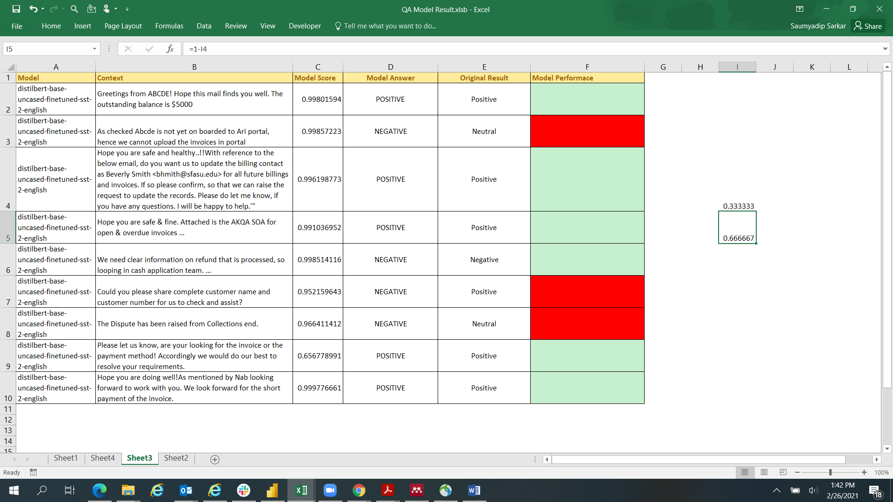
Data Evaluation
Sentiment Analysis
Since this is pre-trained model, no training data was required. It’s applied on actual data.
The outcomes are “Probability Score” and “Model answer” (Positive / Negative)

Slide 14
Deployment
Initial Observations
Models have been handed over to Auditors
Auditors are currently using the models to see if they are able to save time and effort
Initial trials show encouraging result

Slide 15
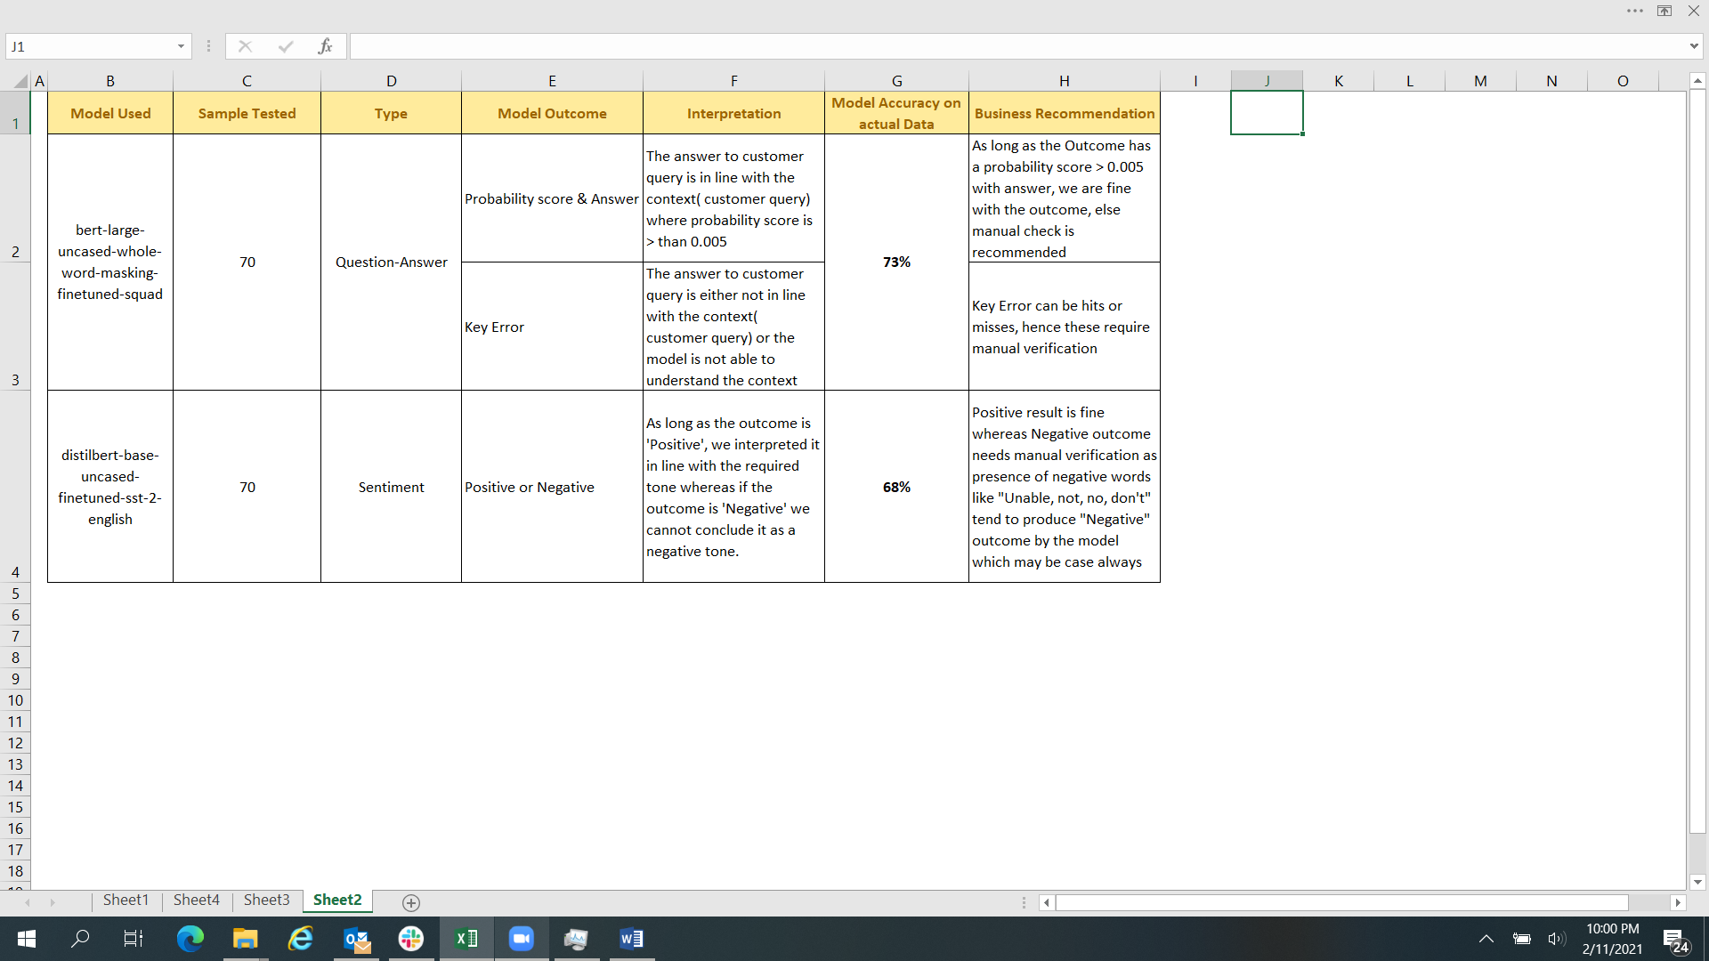
Analysis and Results
Model Outcome
A sample size of 70 incidents where there is only one response are considered
Question-Answer pipeline has an accuracy of 73%
Sentiment Analysis has accuracy of 68%

Slide 16
Analysis and Results
Benefit Analysis
Audit Type | Samples Audit (a) | Avg. Time (in Min) to read & interpret each audit (b) | Total Time Taken (c)=a*b | Interpretation Error / Model Error (d) | Rework Required on samples (e) = c*d | Estimated Time (in Min) on rework (f) = e*10 | Total time (in Min) (g)=c+f
Manual | 70 | 10 | 700 | 12% | 8.4 | 84 | 784
Using Model | 70 | 1 | 70 | 29% | 20.3 | 203 | 273
Estimated time (in Min) saved per Audit (h) = g / a | 7.3 | Avg. number of Audits per month (i) | 287 | Total Time Saved (in Min) (j) = h*i | 2,095 | Total Time Saved (in hrs.) k = j / 60 | 35 | FTE Benefit per day k / (6.5*18) | 0.30
We are close to achieving one third of FTE benefit per day considering 18 working days per month with 6.5 of effective work hour per day.

Slide 17
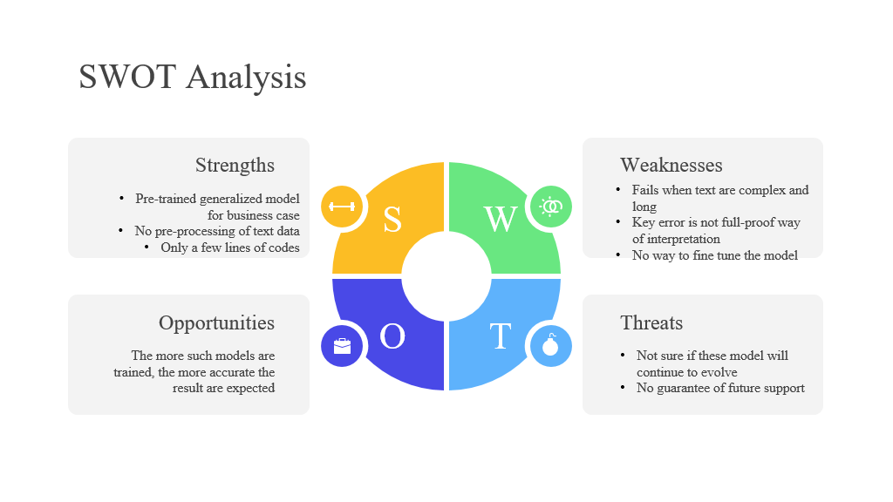
Analysis and Results
SWOT Analysis

Slide 18
Conclusion
Using per-trained model architectures can address almost 60% of our business requirement.
This kind of study will encourage quick adoption of open-source natural language pre-trained models
From preprocessing to final outcome, only a few lines of code are able to achieve great results
This Cost Effective and Time Saving technique can be explored in other business scenarios
These state-of-the-art open architectures available as free source have immense potential in future

Slide 19


Slide 20
Q&A

